Slide 1
World Teacher Day
Building great learning communities together

Slide 2
What is a teacher?
Notes:
What is a teacher?
(Someone who helps students learn by imparting knowledge to them and by setting up a situation in which students can and will learn effectively.)

Slide 3
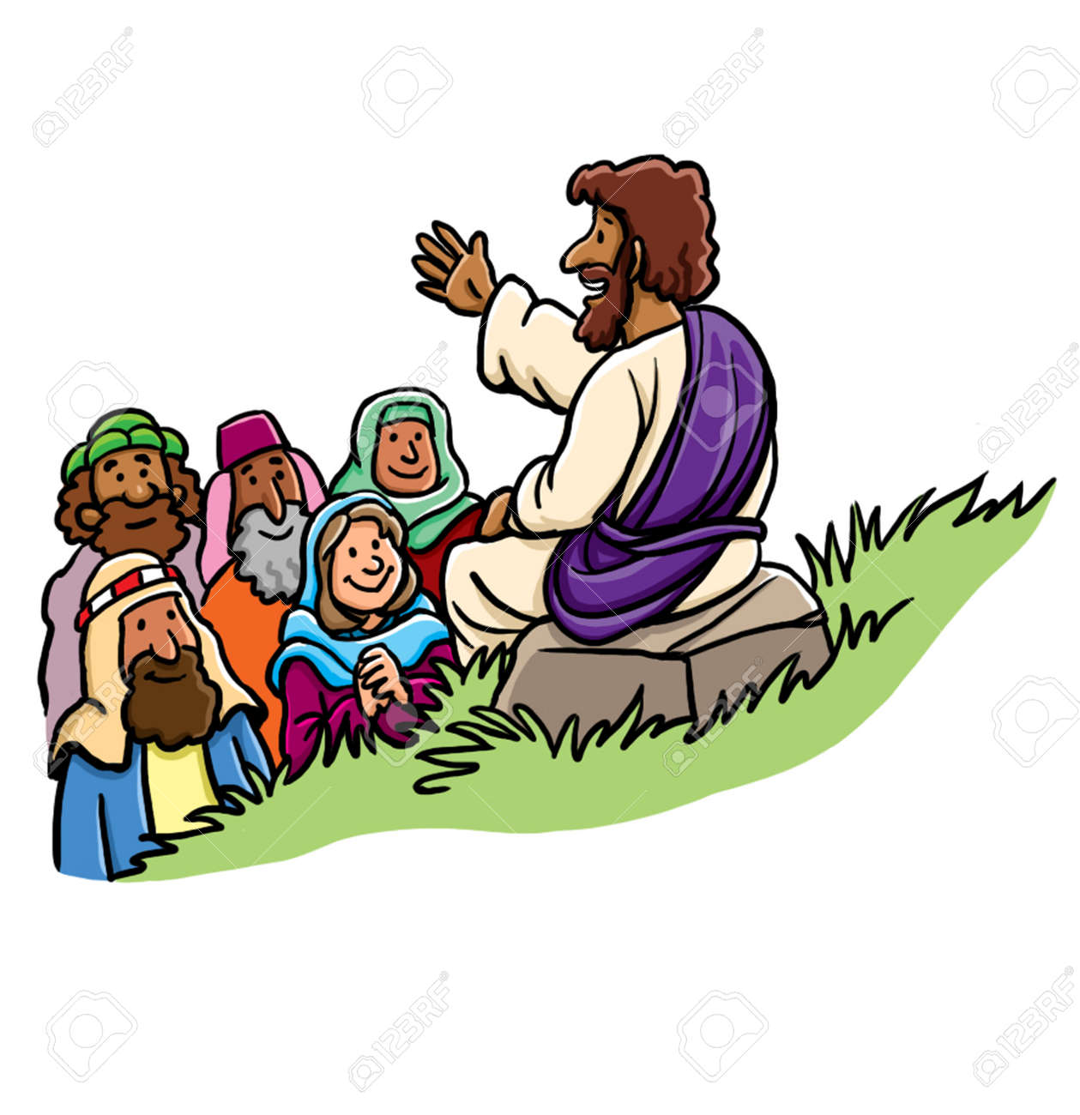
Who is the most famous teacher?
Jesus
Notes:
The most famous teacher is Jesus.

Slide 4
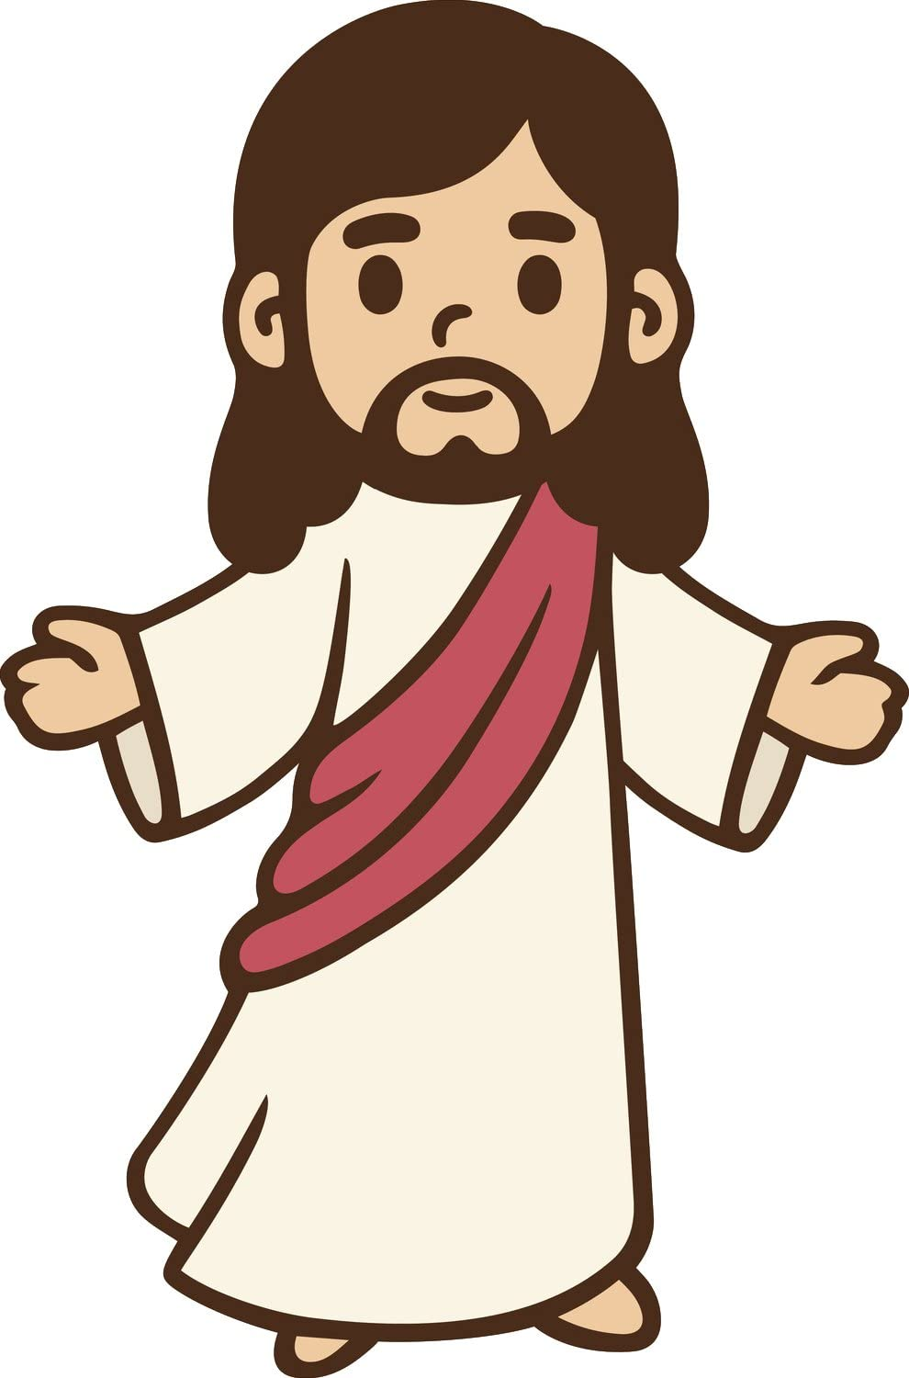
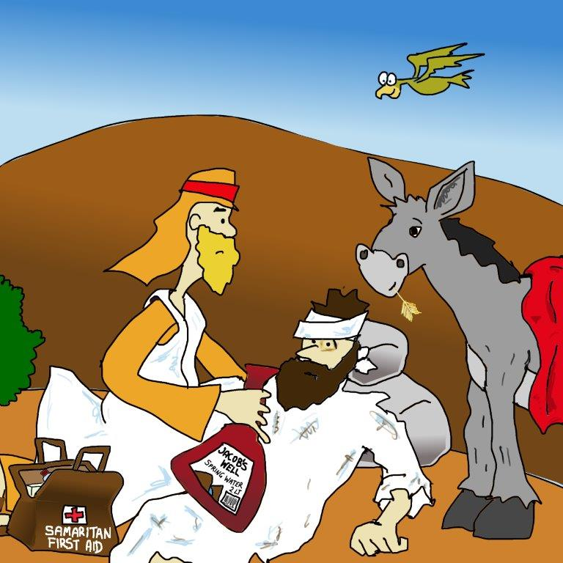
Parables…
Notes:
Jesus taught using stories called parables. Can anyone remember one of Jesus’ parables?
e.g The parable of The Good Samaritan (Luke 10:25-37)

Slide 5
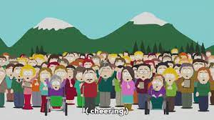
Sermon on the Mount…
Notes:
Jesus taught big groups of people
e.g. Sermon on the Mount (Matthew 5-7)

Slide 6
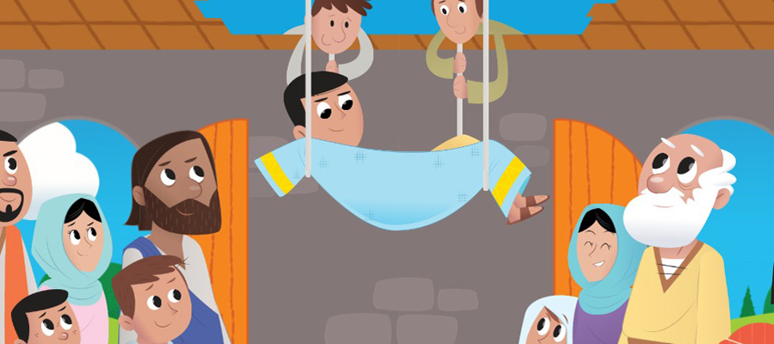
Look at this man…
Notes:
Jesus used opportunities like healings to teach people

Slide 7
Who God is…
How to follow God…
Our future with God…
Trust God…
How to pray…
“Dear God…”
How to behave…
Notes:
Jesus taught us many things, including:
who God the father is?
What it looks like to follow God.
How to pray.
How we should behave.
To trust God.
About our future with God.
…and much more!

Slide 8
What makes a good teacher?
Notes:
Brainstorm: What makes a good teacher?
e.g. compassion, hard work, knowledgeable, wisdom…
Have some pupils from different year groups ready to share about when a teacher made a big difference in their lives.

Slide 9
Thank you to all our teachers!

