Slide 1
Irish
Word Cards

Slide 2
fáilte
Welcome

Slide 3
dia dhuit
Hello

Slide 4
slán
Goodbye

Slide 5
sea
Yes

Slide 6
níl
No

Slide 7
go raibh maith agat
Thank you

Slide 8
le do thoil
Please

Slide 9
brón
Sorry

Slide 10
maidin mhaith
Good Morning

Slide 11
tráthnóna maith
Good Afternoon

Slide 12
tar anseo
Come here

Slide 13
an-mhaith
Well done

Slide 14
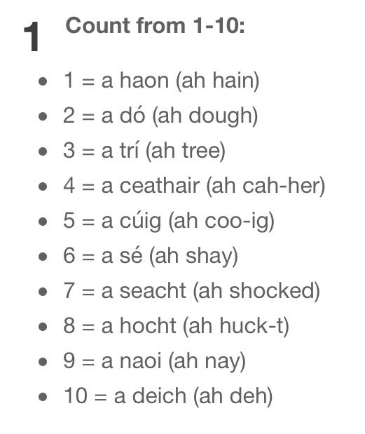

Slide 15
Questions and Answers
Ceist agus Freagra

Slide 16
What is your name? | Cad is ainm duit?
My name is … | … Is ainm dom

Slide 17
How old are you? | Cén aois thú?
I am five years old. | Tá mé cúig bliana d'aois.

Slide 18
How are you? | Conas tá tú?
I am very well. | Tá mé an-mhaith.

Slide 19
What is this? | Cad é seo?
This is a pencil. | Seo peann luaidhe.

Slide 20
Do you understand? | An dtuigeann tú?
I do not understand. | Ní thuigim.

