Slide 1
World Mental Health
Day
Building great learning communities together

Slide 2
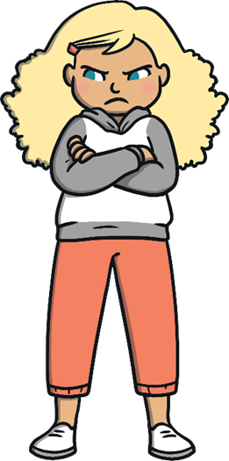
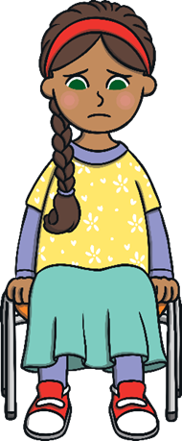
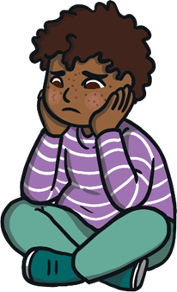
What is mental health?
Mental health is all about how we are feeling and the thoughts we are having.
It can affect how we behave and the choices we make.
Notes:
What is mental health?
Mental health is all about how we are feeling and the thoughts we are having.
It can affect how we behave and the choices we make.

Slide 3
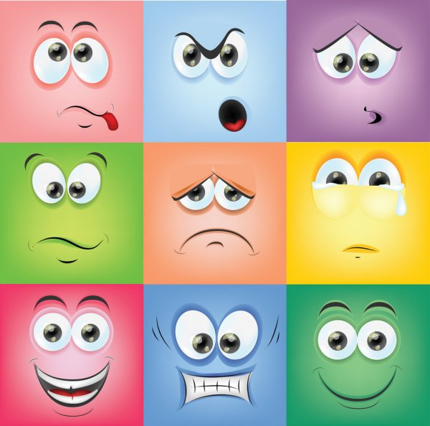
We all have a mix of feelings every day. What are the feelings for each of these faces?
Notes:
Our feelings
We all have a mix of feelings every day.
What are some of the feelings we can have? Sometimes our feelings are happy and give us energy, sometimes our feelings are hard and they make us tired and grumpy.
What are the feelings for each of the faces? (PPT)

Slide 4
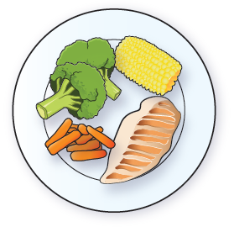
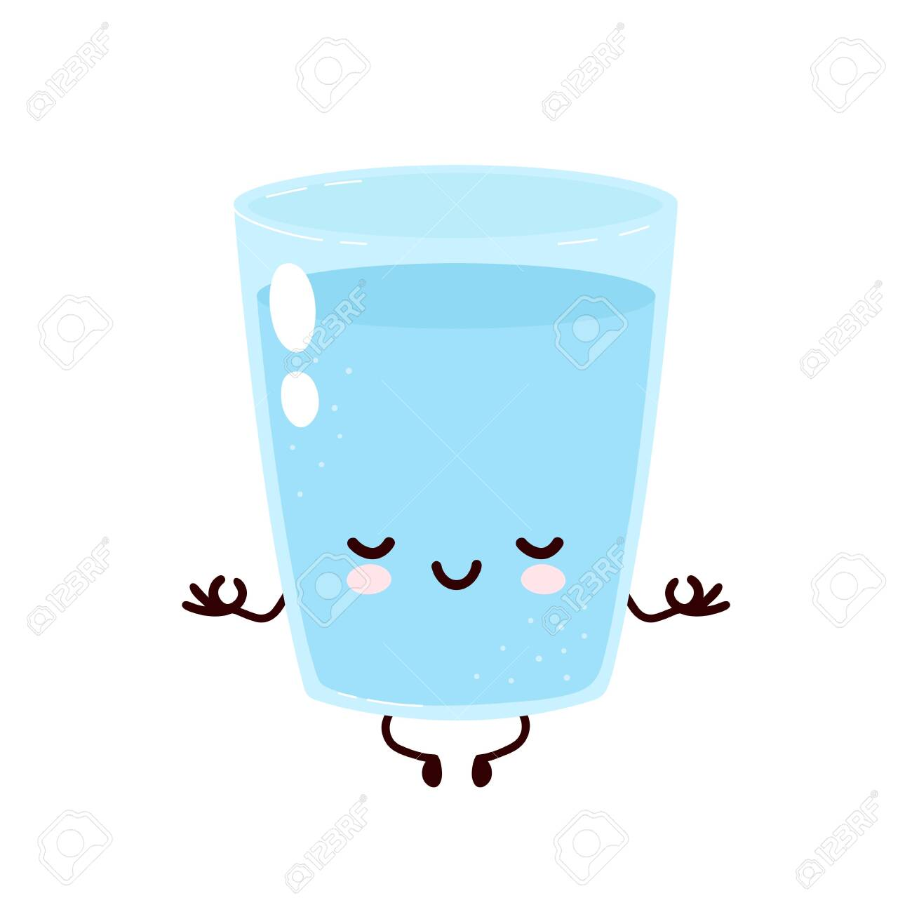
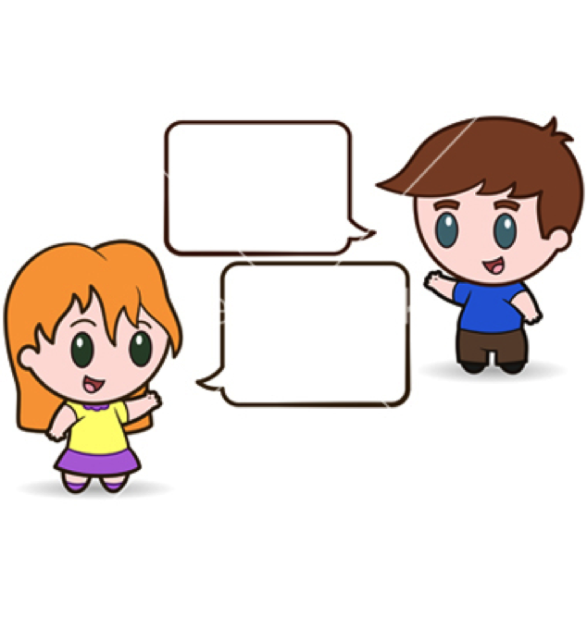
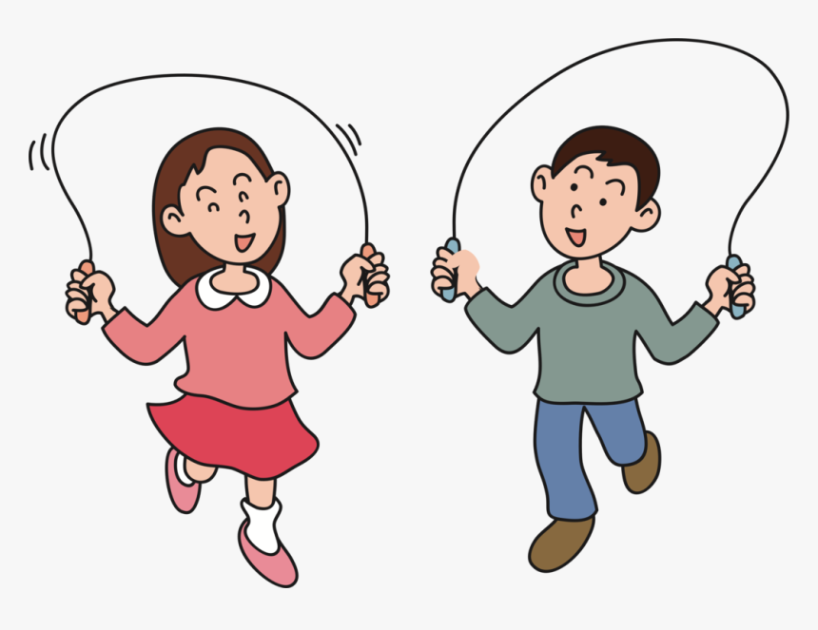
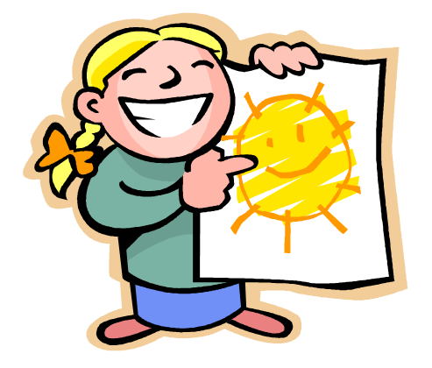
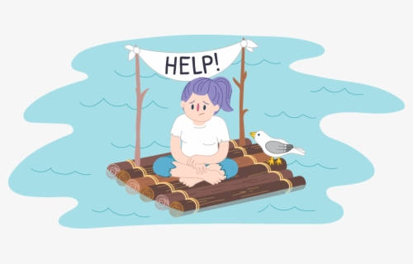
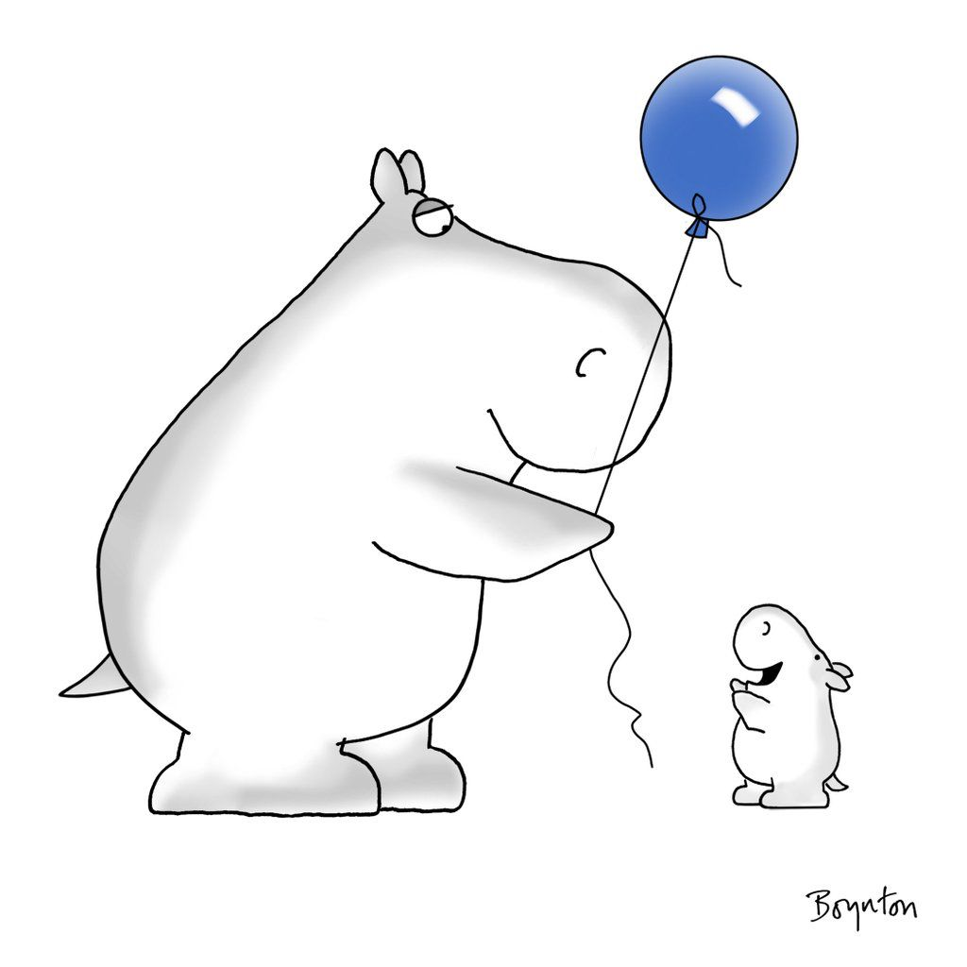
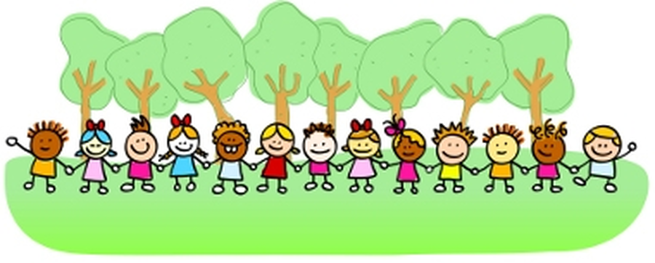
Looking after our mental health
Just like with our body, it is important we do things to help our minds to be healthy, be in good condition and feel well.
What are some things we can do?
Notes:
Looking after our mental health
Just like with our body, it is important we do things to help our minds to be healthy, be in good condition and feel well.
What are some things we can do?
* be physically active;
* eat a balanced diet;
* drink plenty of water;
* get enough sleep;
* talk about our feelings with someone we trust;
* ask for help when something is troubling us;
* make sure we have time each day to be calm and quiet;
* spend time doing something we love;
* spend time outside;
* be creative;
* spend time with people who make us smile;
* help and be kind to others;
* remember we are valuable and worthy just the way we are;
* limit our time watching TV, on social media, the Internet and electronic devices.

Slide 5
Getting help
It is important for anyone struggling with their mental health to get help to feel better, just like they would with their physical health.
There is a lot we can do to help ourselves feel better but sometimes further help from others is needed.
Notes:
Getting help
It is important for anyone struggling with their mental health to get help to feel better, just like they would with their physical health.
There is a lot we can do to help ourselves feel better but sometimes further help from others is needed.
o Talk to someone we trust, and we can talk to a trusted adult in our family or at school.
o Talk to your doctor.
o Call Childline on 0800 1111.
o Call 999 if we are in immediate danger.

Slide 6
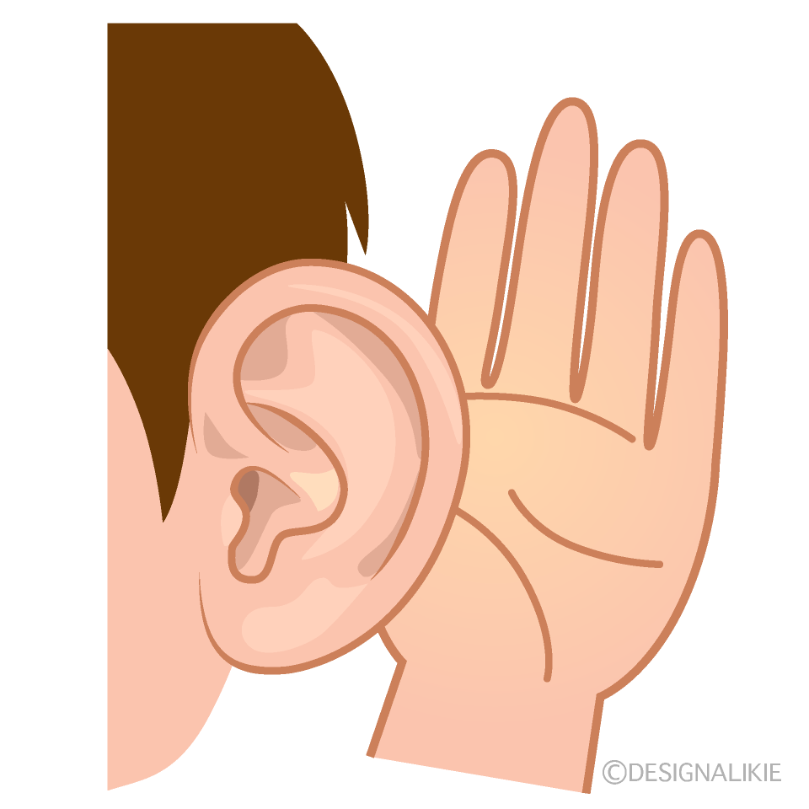
Supporting others
How does it feel when someone helps you with something you are finding tricky?
It feels good to give and receive help. There are ways we can help when people we know are struggling with their mental health.
Notes:
Supporting others
How does it feel when someone helps you with something you are finding tricky?
It feels good to give and receive help. There are ways we can help when people we know are struggling with their mental health.
God tells us to Love our neighbour. What might that look like?

Slide 7
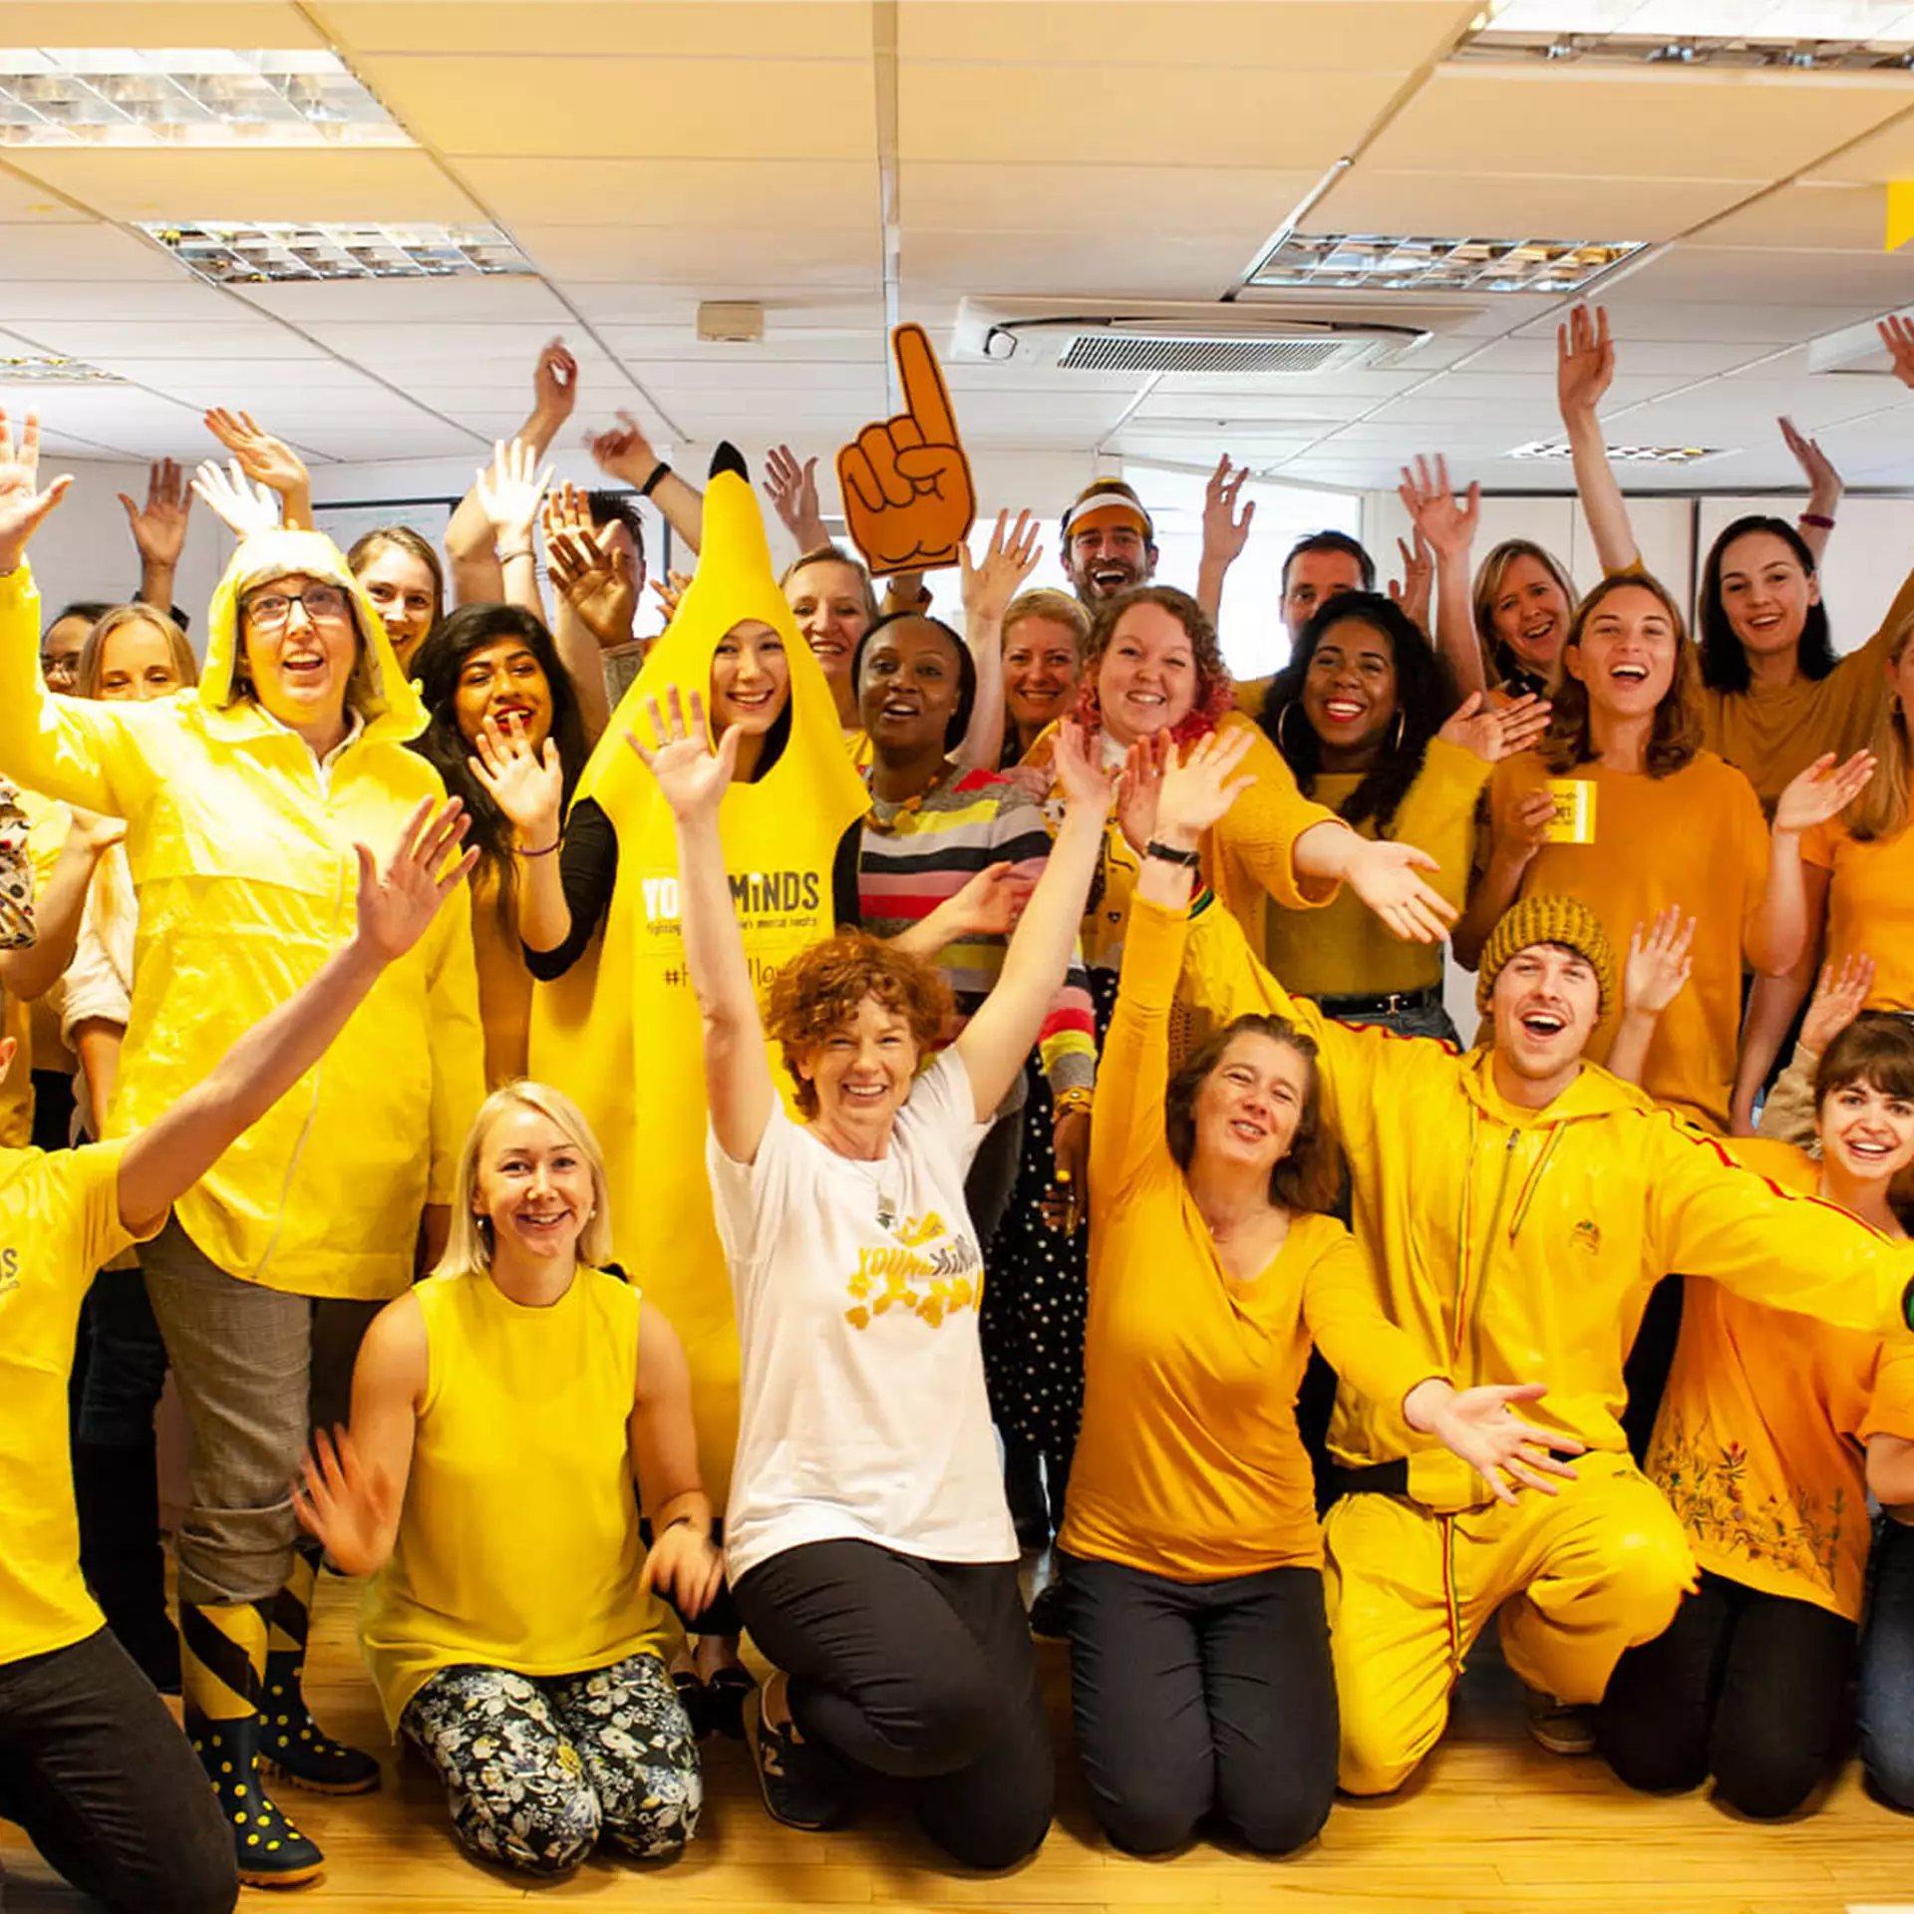
Hello Yellow Day
On Hello Yellow Day people wear yellow to show young people that how they feel matters, and to help create a more positive future

Slide 8
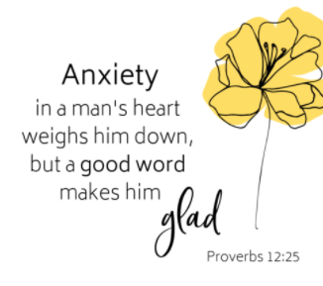
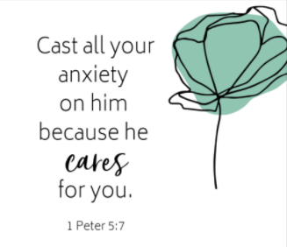
Reflection
Who can you talk to about how you’re feeling?
Who are you going to show kindness to today?
Notes:
God tells us to trust in Him even when it feels too hard.
God also tells us to show kindness and look out for those who are struggling.

Slide 9
Prayer
Thank you that you are our God and you are with us, that you hold us in your hands and help and strengthen us when life is hard.
Help us to show the same kindness you show us to other people.
AMEN

Slide 10
Thank you!

